Slide 1


Coffee Hub
1 |  | N5 Financials
2 |  | Understanding Green Coffee
3 |  | Category & Consumer
4 |  | Plays Detail
5 |  | Artemis Coffee 1.0

Slide 2
Coffee Hub
1 |  | N5 Financials
2 |  | Understanding Green Coffee
3 |  | Category & Consumer
4 |  | Plays Detail
5 |  | Artemis Coffee 1.0

Slide 3
N5 2025-2032
Coffee HUB
Projection
2032
Growth
2026-2032
BIA COFFEE
$ 652 | 14% CAGR
$ 188 | 25% CAGR
29% | 11.6pp
REVENUE
N5
EBITDA
2026-2032
EBITDA
MARGIN
Notes:
Separar el EBITDA MARGIN en una table con los PP de crecimiento con respect a 2025

Slide 4
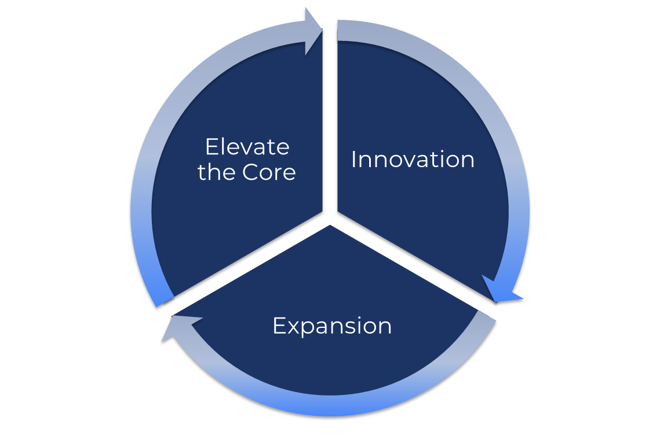
N5 2025-2032
Coffee HUB
Growth Pillars
Operating model to create & capture value
Strengthen our Core Coffee portfolio & our Core Brands excelling at the basics
Differentiate and evolve our Coffee Brands ensuring consumer centricity & segment momentum
RGM & Product Architecture
Renovate brands
portfolio Strategy
Efficiencies
Innovate in winning platforms deploying portfolio strategy
Expanding coffee business beyond borders/channels, focused on Out of Home opportunity
Extending our coffee solutions to Hotels, restaurants, convenience & offices

Slide 5
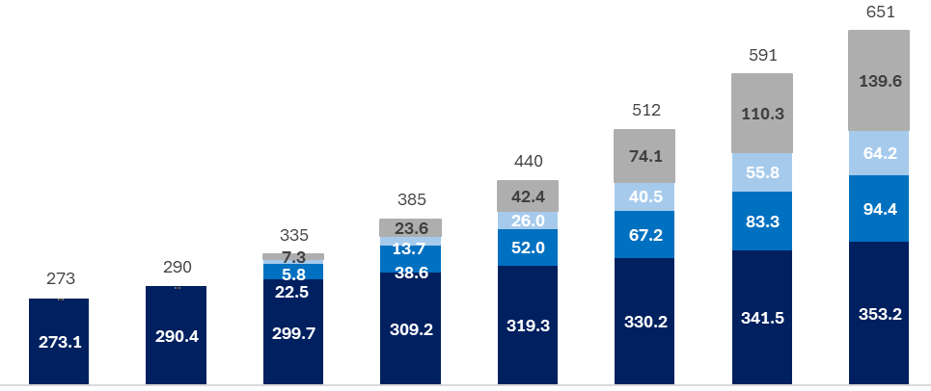
N5 2025-2032
Coffee HUB
N5 2026-2032 | Growth Plays boosting growth baseline to 2.2X by 2032
Top Line Baseline vs Plays $Mn
Highlights
Baseline 5Y CAGR +3.3% growing in line with CPI + Industry Volumes
Elevate The Core initiatives enhancing our current portfolio and excelling at the basics (RGM, RTM)
Innovation focus in key value-added territories expanding the reach of our brands
Expansion driving growth focused on OOH channel and Exports activities
Baseline
Elevate the Core
Innovation
Expansion
1
14.4%
CAGR
TOTAL
2
3
4
3.3%
CAGR
Baseline
2025
2026
2027
2028
2029
2030
2031
2032
Figures in US$ Millions and/or Percentages

Slide 6
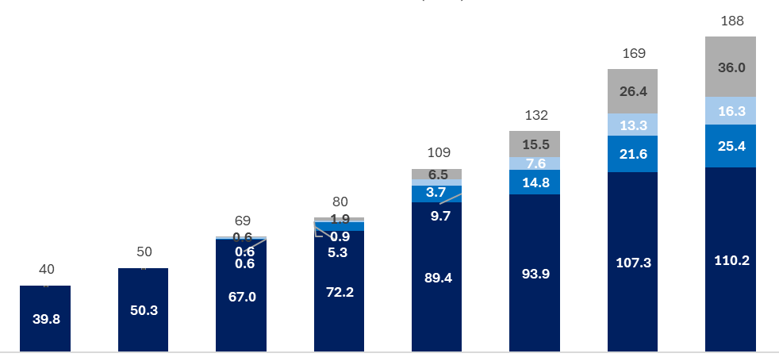
N5 2025-2032
Coffee HUB
N5 2026-2032 | EBITDA consolidated plays 3.7X from 2026 to 2032
EBITDA Baseline vs Plays $Mn
Highlights
Base line driving EBITDA growth leveraging cost optimization for the N5 period
Elevate The Core initiatives investing incremental margin in brand building
Innovation investing all its initial margin to seed key bets
Expansion Margin leveraging lower cost to invest in OOH platform
Baseline
Elevate the Core
Innovation
Expansion
1
25%
CAGR
TOTAL
2
3
4
0
14%
CAGR
Baseline
2025
2026
2027
2028
2029
2030
2031
2032
Figures in US$ Millions and/or Percentages

Slide 7
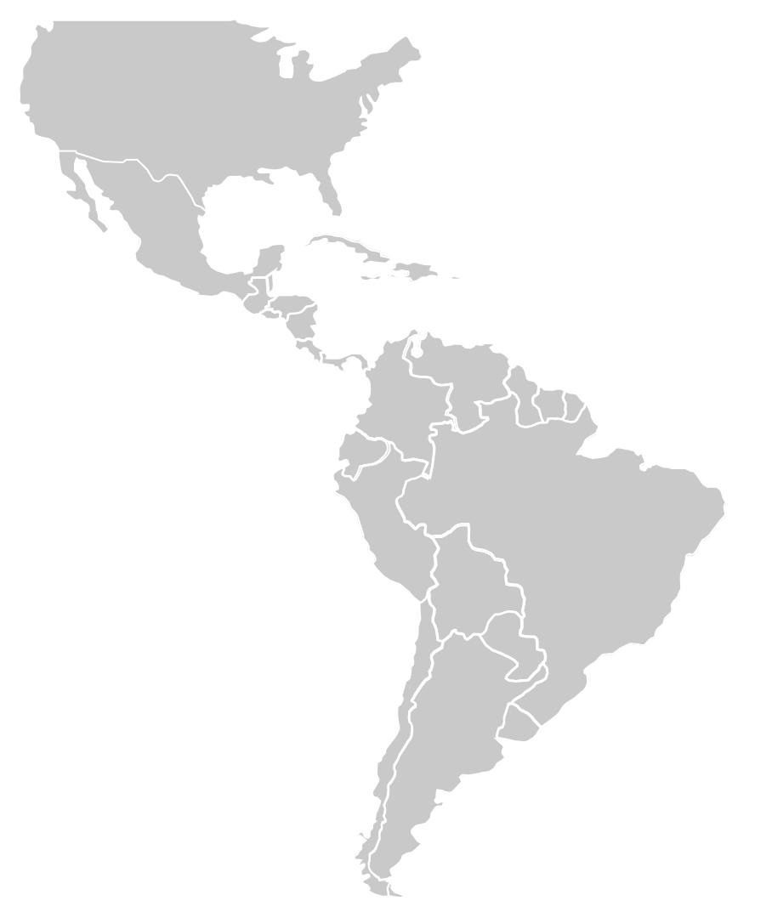











N5 2025-2032
Coffee HUB
Continue Building Our Ambition
Becoming the fastest growth COFFEE HOUSE OF BRANDS in the Americas
From | To
2025 | 2032
Topline | Topline
$273M | $652M
$40M | $188M
EBITDA | EBITDA

Slide 8
N5 2025-2032
Coffee HUB
Continue Building Our Ambition
Becoming the fastest growth COFFEE HOUSE OF BRANDS in the Americas
From | To
Value Projections 2025 | Value Projections 2025
Topline | Topline
$500M | $648M
$171M | $182M
EBITDA | EBITDA

Slide 9
Coffee Hub
1 |  | N5 Financials
2 |  | Understanding Green Coffee
3 |  | Category & Consumer
4 |  | Plays Detail
5 |  | Artemis Coffee 1.0

Slide 10
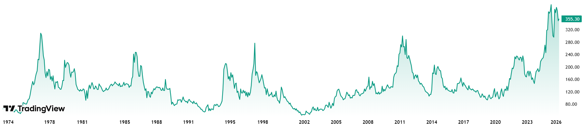
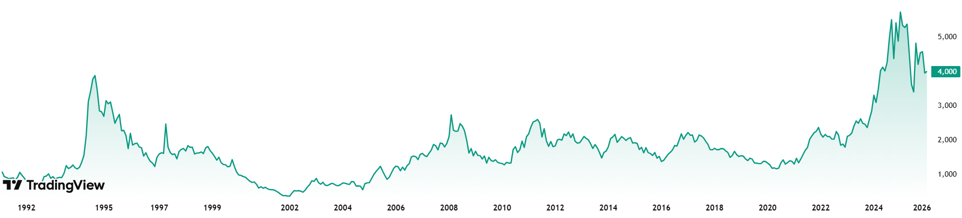

N5 2025-2032
Coffee HUB
Where we see Green Coffee Cycle
NY Market
London Market
NY Arabica Coffee $/lb
1973-2026
London Robusta Coffee $/Mt
2008-2026
+$355/lb
+$4000/Mt
There is a new reality in the high & low coffee prices
Expecting that the worst has passed

Slide 11

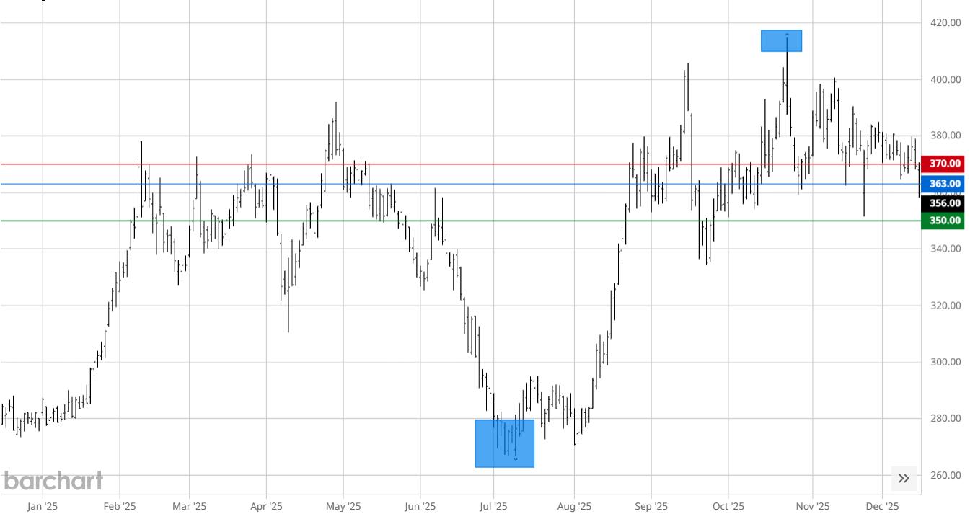
N5 2025-2032
Coffee HUB
Where we see Green Coffee Cycle
Coffee Futures manifesting a down cycle
Key Takeaways
Short term Zoom
Coffee prices started to show a Price decrease in July 2025
Tariffs to Brazil reversed Price trend
Futures market show a down cycle for 2027-2028
Appears that the “worst is over”.
2026 crops announcing a positive outcome
Arabica
2023-2026 $/lb
Implications
Expect headwinds for green Coffee
Expect a green coffee down cycle for N5 period
Do not expect prices to go below $250/lb
Expect Competitors to become more aggressive
Expect marketing investment to increase
Expect an increase in Tade Dynamic
Expect Mainstream segment to recover & value segment to slow down.
Arabica Futures
03/2026 – 03/2028 $/lb
$355/lb
$297/lb

Slide 12
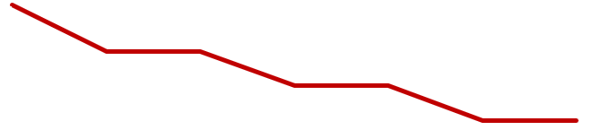
N5 2025-2032
Coffee HUB
Where we see Green Coffee Cycle
N5 Green Coffee projection
Green Coffee cost assumption 2026-3032
Projection assumption $355/lb - $250/lb
Forecasted a conservative down-cycle (under new reality)
Projections based on improvement of marginal contribution
A more aggressive down cycle will optimize our marginal contribution, generating more investment & value.
Highlights
2026
$350/Lb
$250/Lb
2027
2028
2029
2030
2031
2032

Slide 13
Coffee Hub
1 |  | N5 Financials
2 |  | Understanding Green Coffee
3 |  | Category & Consumer
4 |  | Plays Detail
5 |  | Artemis Coffee 1.0

Slide 14







N5 2025-2032
Coffee HUB
How do we see the Category
Category mapping Latam bia Markets– Category value +16% growth 2026 vs 2025
$2Bn - 25%
$5.9Bn – 75%
$7.9 Bn
Total
$2.2 Bn
$1.2 Bn
$1 Bn
$1 Bn
$0.5 Bn
In home
Horeca
Street
Coffee
Shops
Conv
Office

Slide 15
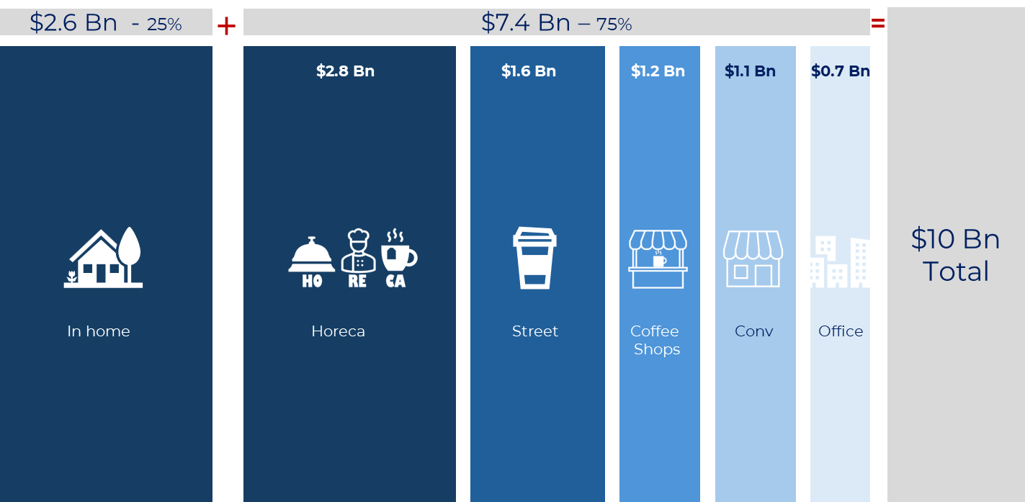
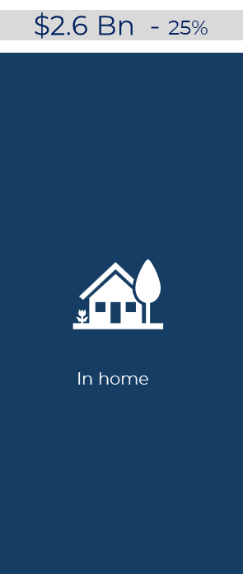
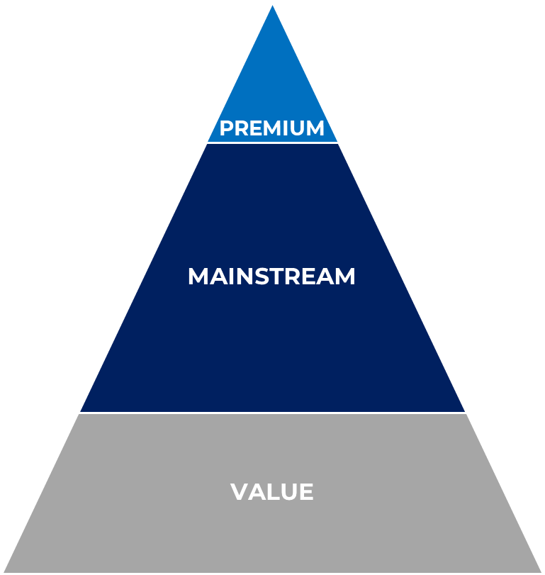









N5 2025-2032
Coffee HUB
Category Projections for 2032
Understanding the different segments
COFFEE CATEGORY (2032)
OUT OF HOME
IN-HOME
OOH market divided 5 segments
In-home market divided 3 segments
Coffee Market Val
$10 Bn
Total
$0.6 Bn
Coffee OOH
$7.4 Bn
Coffee In home
$2.6 Bn
$1.2 Bn
$0.8 Bn
37%
21%
16%
16%
9%
MX Coffee Cat
$7.4 Bn
76% share
$5.7Bn
77% share
$1.7 Bn
73% share
MX
MX
GT-HN-CR Coffee Cat
$1.9 Bn
17% share
$1.2 Bn
16% share
$0.7 Bn
21% share
GT-HN-CR
GT-HN-CR
$0.5 Bn
7% share
ECU
$0.2 Bn
6% share
ECU Coffee Cat
$0.7 Bn
7% share
ECU

Slide 16
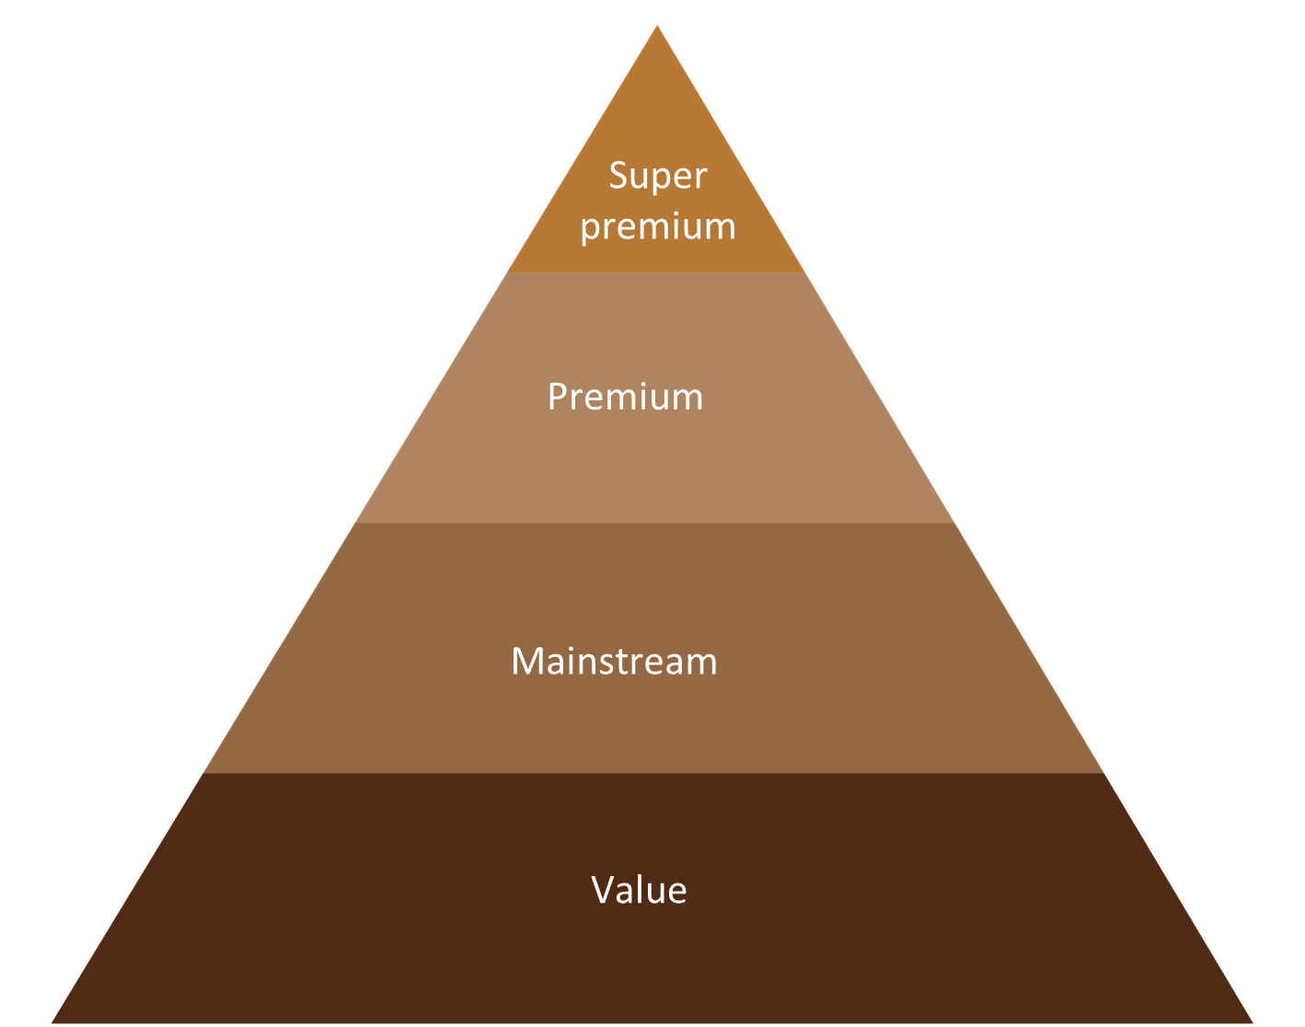
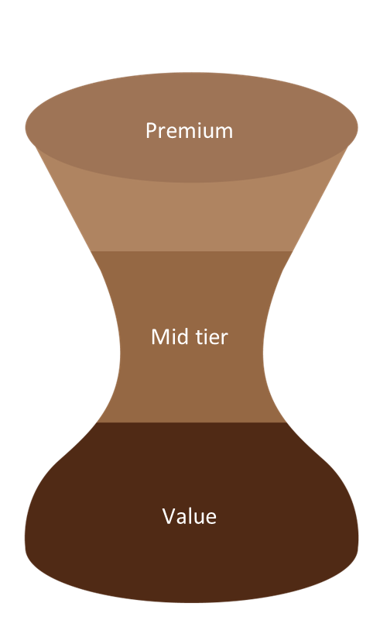






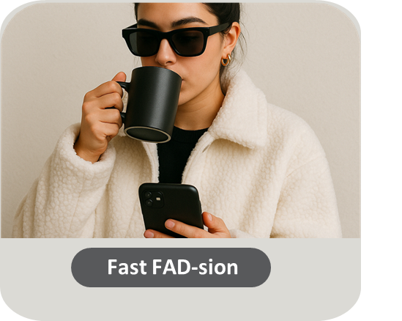







N5 2025-2032
Coffee HUB
Category & Consumer trends
What happened to the different segments & consumer typologies
Value vs Volume
Segment evolution
Price Increases
Cat. Volume
Cat. Value
+10% to +40%
-5% to +3%
+10% to +25%
Consumer Behavior
Key Competitors Performance
Winners
Struggling
Premium
Coffeeshop
Mainstream

Slide 17






Consumer Typology
Innovative​ driven
Fast FAD-sion
Status Matters
Friendly Student
L
I
Cofee Lover Connosseuri
Functional
COFFEE
Emotional
E
Good For You
Conservative Grounded​

Slide 18
Consumer Typology
Coffeeshop Territory
Innovative​ driven
Premium Territory
Fast FAD-sion
Status Matters
Good For You / Performance Territory
Mainstream
Territory
Cofee Lover Connosseuri
Friendly Student
L
I
Functional
COFFEE
Emotional
E
Good For You
Conservative Grounded​

Slide 19
Coffee Hub
1 |  | N5 Financials
2 |  | Understanding Green Coffee
3 |  | Category & Consumer
4 |  | Plays Detail
5 |  | Artemis Coffee 1.0

Slide 20



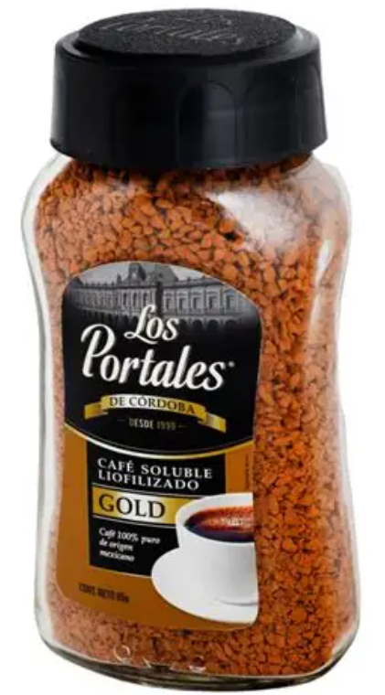

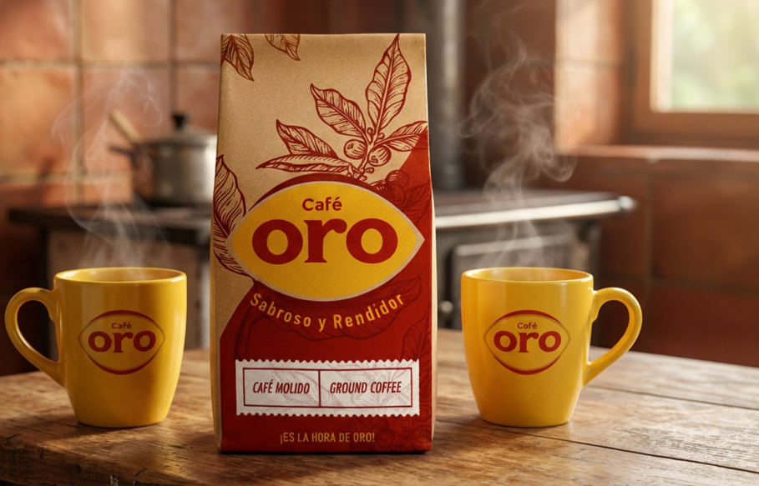

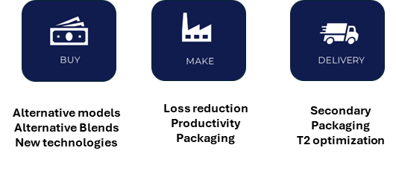
N5 2025-2032
Coffee HUB
Elevate the Core – $XXX Top Line $YY EBITDA
Strengthen our Core Coffee portfolio & our Core Brands excelling at the basics
Defend & grow our
Core Mainstream
Protect our
Value Leadership
Accelerate
Mainstream Plus & Premium
Defend our legacy brands & our core volume as priority
Keep investing in our top brands
Excell at the basics: RGM POS DIST EXCECU.
Protect & Grow our Value Brands ensuring their proper INDEX & competitive Price Point.
Ensure best in class low-cost manufacturing capabilities in Honduras, Costa Rica &
Accelerate Soluble Mainstream plus Platform: – Continue investing behind Portales GOLD in MEX & Café Oro in Ecuador.
Accelerate roll out in Key Market Honduras & Guatemala
Reinforce Premium Brands in MEX & Guatemala.
CR, ECU, MEX
CR & HN
MEX, ECU

Slide 21

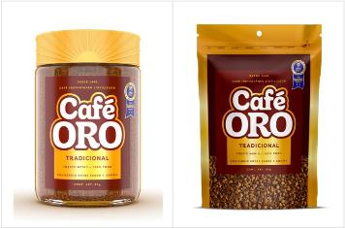

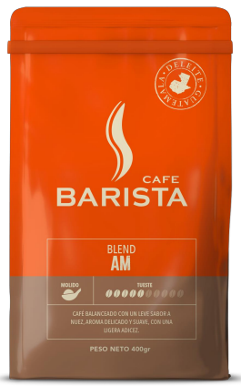
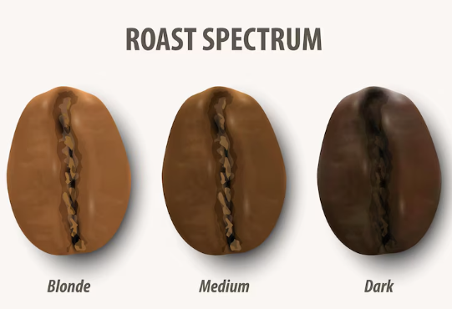

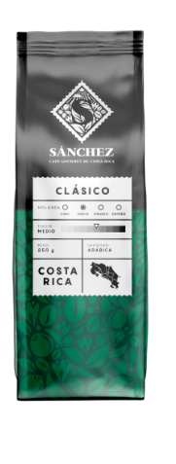


N5 2025-2032
Coffee HUB
Innovation– $XXX Top Line $YY EBITDA
Differentiate and evolve our Coffee Brands ensuring consumer centricity & segment momentum
Further Develop
Affordable Solutions
Lead
Premiumization
Bring news to our
Mainstream
Expand R&G affordable solutions to Guatemala, MEX & Costa Rica leveraging HON capabilities
Develop Soluble mixes to enter Value in MEX, Ecuador & Guatemala
Innovate in R&G Premium building coffee expertise
Lead premium innovation in MEX with PDC & Guatemala Barista
Enter Premium segment in HON, ECU
Develop Sanchez Platform in Costa Rica
Innovate & complement Soluble mainstream plus platform: Roast spectrum & origins
Introduce/expand solutions in Mainstream Plus R&G in key markets (Flavor platform, holiday platform)
WIP
Seasonals, In&outs, Origins formats
MEX, GT & ECU
MEX, GT & ECU
MEX, CR, HN

Slide 22



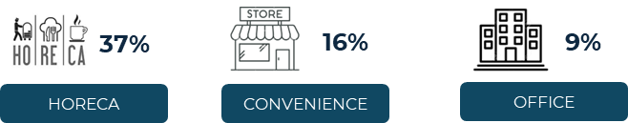
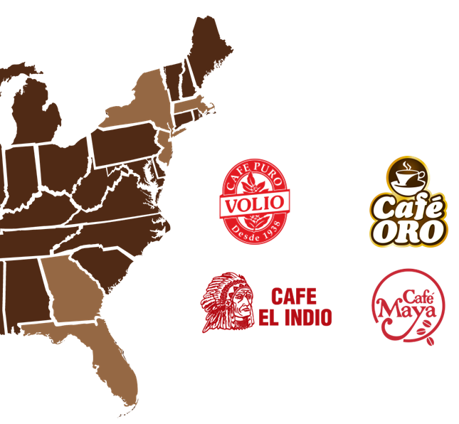


N5 2025-2032
Coffee HUB
Expansion– $XXX Top Line $YY EBITDA
Expanding coffee business beyond current channels & borders
Enter
Out of Home
Conquer
US Hispanic Market
Develop
Export Markets
Address Out-of-Home opportunity
Focus in 3 Key Segments
ARTEMIS priority #1
Develop MEX brands Coffee pillar (IMM/Sn. Marcos)
Bring Coffee solutions to nostalgic market
Accelerate Peru Business case
Accelerate expansion to El Salvador from GT.
3X vs In-home

Slide 23
N5 2025-2032
Coffee HUB
N5 Summary– Deploying our plays in the markets
Elevate the Core
Innovation
Expansion

Slide 24
N5 2025-2032
Coffee HUB
BULLET PROOF – Zooming in US Functional Coffee
Expanding coffee business beyond current channels & borders
Elevating the Core
Innovation
Expansion
XXXXXXX
XXXXXXXX
ZZZZZZ
WIP
WIP
WIP

Slide 25
Coffee Hub
1 |  | N5 Financials
2 |  | Understanding Green Coffee
3 |  | Category & Consumer
4 |  | Plays Detail
5 |  | Artemis Coffee 1.0

Slide 26
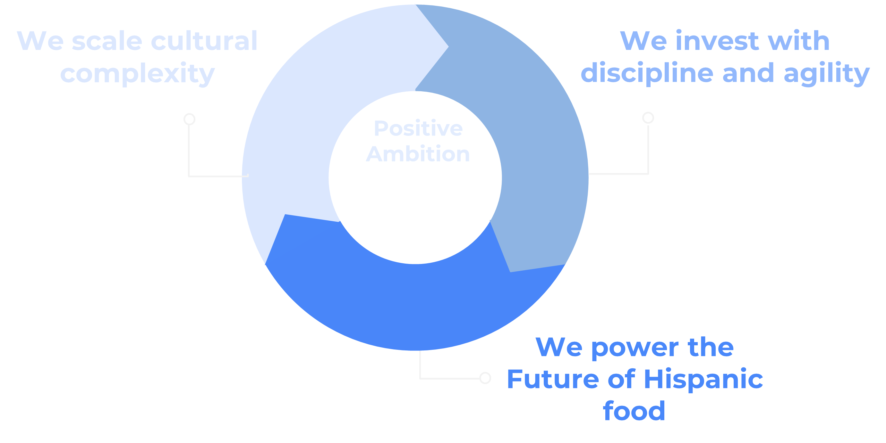




The Bia Way
The Bia Way
Elevate the Core
Enhance our current portfolio
Brand building
RGM, RTM, POS
Expansion
New Geographies
New Channels
Innovation
Extend our portfolio
Expand occasions
Bring news to the category
ARTEMIS
Vision
& Strategy
EVEREST
Sustainable
Cash Flow
GAUDI
Talent and
Org. Evolution
S&OP
Operational
Effectiveness
N5 Badia
Notes:
“We turn cultural complexity into executional advantage—delivering the most trusted Hispanic assortment to every U.S. consumer,”

Slide 27







Coffee Hub:
ARTEMIS
Artemis Coffee 1.0
“Following the Artemis principle, the goal is not the initial Landing, is building robust plans that bring the vision to life”
Ambitious,
Long-Term Vision
Disciplined
Phased Execution
Strategic
Alliances
Innovation
New
Capabilities
Building
sustainable solutions
Notes:
“We turn cultural complexity into executional advantage—delivering the most trusted Hispanic assortment to every U.S. consumer,”

Slide 28
Coffee Hub:
ARTEMIS
Artemis Ambition
30%
CAGR
1Bn Net Rev.
Ambition
14% CAGR
0.6BnNet Rev.
N5 Projection
Understanding the playing field to identify growing opportunities seeking a constant growth beyond N5
Notes:
“We turn cultural complexity into executional advantage—delivering the most trusted Hispanic assortment to every U.S. consumer,”

Slide 29


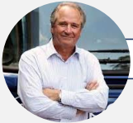











Artemis Coffee 1.0 – Focus Vertical Coffee Latam Leadership Team
THE NOURISHING ALLIANCE
Steering Committee
CEO
Invitado
Invitado
Luciano Carillo
Carlos Enrique Mata
Juan Pablo Mata
Director
CEO Owner
Advisors
Luis Alberto Paiz
Daniel Lopez
Ernesto Berrios
Caio Miranda
Lead Team
Expert Team
Data
B2B
Project Owner
G&G
M&A
Supply Chain
Luis Jimenez
Diego De Leon
Verónica Cosenza
Carolina Vasquez
(TBC Caio)
Mariposa Capital
Cesar Zuñiga

Slide 30
N5 PLAYS – Connecting N5 to Artemis
THE NOURISHING ALLIANCE
By understanding consumption occasions and segments, we can clearly see how to deploy our portfolio strategy in each market and identify Common Platforms
Elevate the Core
Innovation
Expansion

Slide 31
N5 PLAYS – Identifying common platforms
THE NOURISHING ALLIANCE
Grouping workstreams beyond N5
Market Driven
Market Driven
Artemis
Market Driven
Artemis
Elevate the Core
Innovation
Expansion

Slide 32
Artemis Coffee 1.0 – Workstreams
THE NOURISHING ALLIANCE
Shorter term workstreams driven by Markets
WORKSTREAMS
Elevate Core
Innovation
Expansion
Market
Lead
Brand Building
Mainstream Plus Soluble
Premium R&G
OOH
Capabilities
M&A
Brands Rejuvenation:
VBBP/BVI
CCI
Portfolio Strategy:
Accelerate, Defend, Transform and Seed
Accelerate value added brands:
ORO: HN – GT - ECU
Manufacturing
Capabilities
Develop Premium Portfolio
Capsules – Espresso/Dolce Gusto
Specialities
Seasonals
Premium
Oro: ECU-CR
Launch OOH:
Horeca
Convenience
Office
Soluble Manufacturing:
Key targets:
Meet strategic criteria
JV/M&A - CAFESCA
SV – Colcafé/Riko
GUA – La Jarillita
ECU – Gardella/Minerva
HN - Cafetano
Segments:
Mainstream Plus/
Premium (Liofilizado)
Aglomerado (CAM)
ENABLERS
People
Capex
RTM
Alternative Business Models

Slide 33
Artemis Coffee 1.0 – Workstream and Priorities
THE NOURISHING ALLIANCE
Expansion workstreams Driven by Artemis Team.
WORKSTREAMS
Elevate Core
Innovation
Expansion
Market
Lead
Priority 1 Artemis
Priority 2 Artemis
Priority 3 Artemis
Brand Building
Mainstream Plus Soluble
Premium R&G
OOH
Capabilities
M&A
Brands Rejuvenation:
VBBP/BVI
CCI
Portfolio Strategy:
Accelerate, Defend, Transform and Seed
Accelerate value added brands:
ORO: HN – GT - ECU
Manufacturing
Capabilities
Develop Premium Portfolio
Capsules – Espresso/Dolce Gusto
Specialities
Seasonals
Premium
Oro: ECU-CR
Launch OOH:
Horeca
Convenience
Office
Soluble Manufacturing:
Key players:
Meet strategic criteria
JV/M&A - CAFESCA
SV - Colcafé
GUA – La Jarillita
ECU – Gardella/Minerva
HN - Cafetano
Segments:
Mainstream Plus/
Premium (Liofilizado)
Aglomerado (CAM)
ENABLERS
People
Capex
RTM
Alternative Business Models

Slide 34


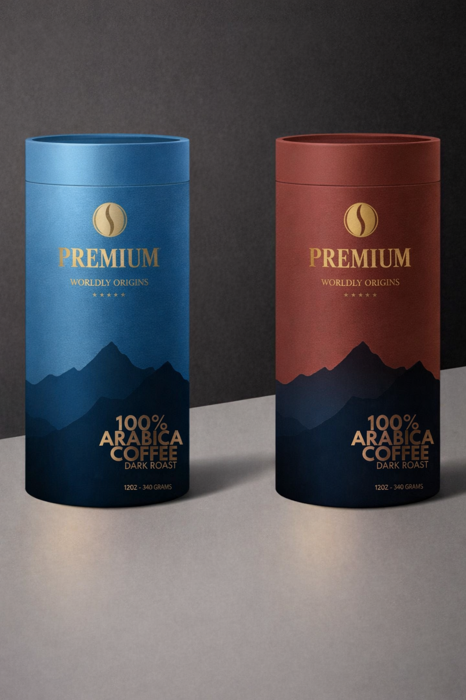


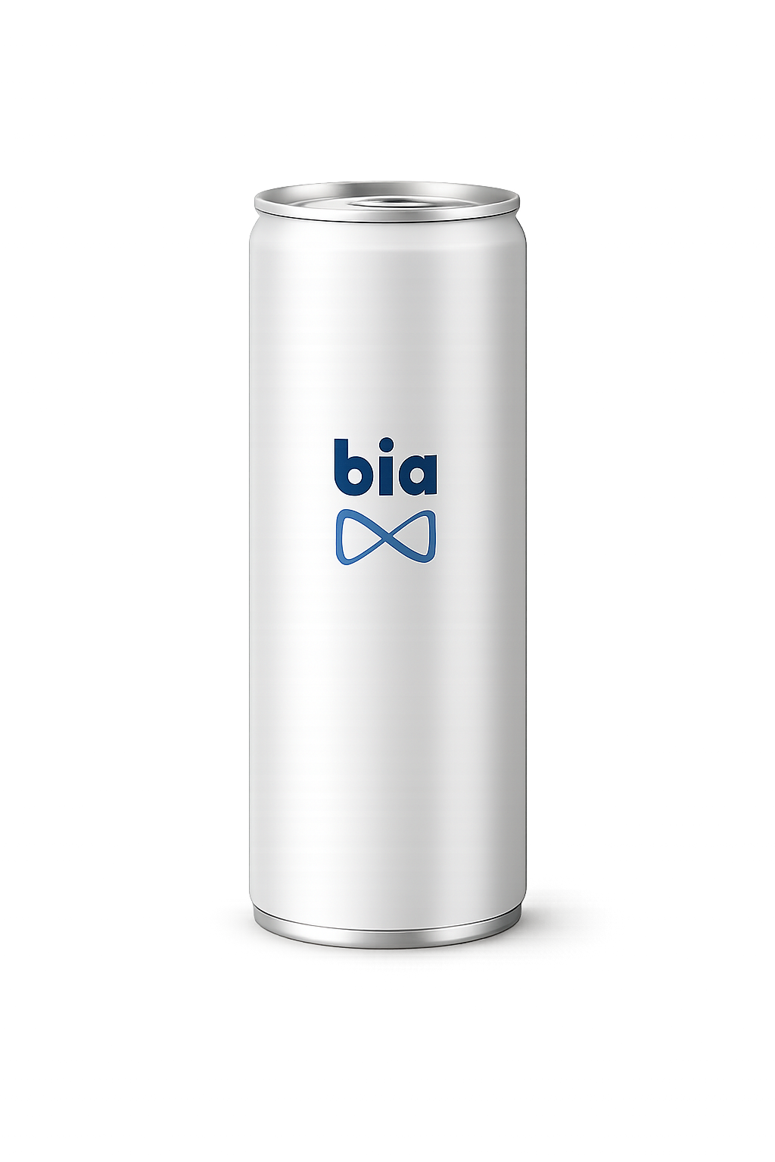
Artemis Coffee 1.0 – Other common platforms Artemis will drive
Across markets solutions that enable N5 Plays.
Premium
Brand Development and Positioning
Capsules solutions
Seasonals
Packaging scope
(glass, flexible, pet, etc.)
New business Models
(Ready to Drink)

Slide 35
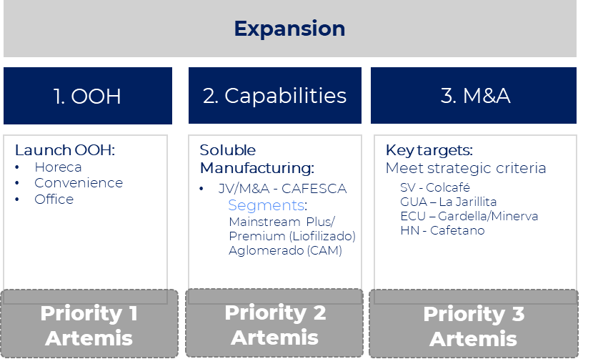

Artemis Coffee 1.0 –Workstream 1 - OOH
THE NOURISHING ALLIANCE
By prioritizing the workstreams , we define the owners responsable for mapping, assessing, and recommending the strategic actions for Priority 1 Artemis Coffee 1.0 - OOH
WORKSTREAMS
Expansion
1. OOH
Lead Team
Expert Team
Verónica
Cosenza
Diego de Leon
Champion
Mauricio
Carvajal
Luis
Jimenez
Carolina Vasquez
(TBC Caio)
Market Lead
Champion Local
Expert
Advisor
ENABLERS
Capex
RTM
Alternative Business Model
Research & Data Tools
Additional Structure

Slide 36
Why Out of home?
COFFEE HUB LATAM
Out Of Home (OOH) is not just another segment; it represents 75% of the value of the Coffee industry in countries where Bia has a presence, equivalent to $7 billion by 2032
THE NOURISHING ALLIANCE
LATAM
TOTAL ADDRESSABLE MARKET
$10 Bn
Coffee Market Value
TOTAL ADDRESSABLE MARKET
OOH MARKET VALUE
$7 Bn
OOH segment
MARKET VALUE
SERVICE ADDRESSABLE MARKET
$4 Bn
HORECA / Convenience / Office Channel
SERVICE ADDRESSABLE MARKET
SERVICE OBTAINABLE MARKET
$84 M
N5 Projections to 2032
SERVICE OBTAINABLE MARKET
N5

Slide 37
Why Out of home?
COFFEE HUB LATAM
Separating CAS and Mexico is essential for understanding the scale and opportunities in both regions
THE NOURISHING ALLIANCE
CAS
MÉXICO
MÉXICO
$2.3 Bn
Coffee Market Value
TOTAL ADDRESSABLE MARKET
$7.4 Bn
Coffee Market Value
TOTAL ADDRESSABLE MARKET
TOTAL ADDRESSABLE MARKET
$1.7 Bn
OOH segment
MARKET VALUE
$5 Bn
OOH segment
MARKET VALUE
OOH MARKET VALUE
$1 Bn
HORECA / Convenience / Office Channel
SERVICE ADDRESSABLE MARKET
SERVICE ADDRESSABLE MARKET
$3 Bn
HORECA / Convenience / Office Channel
SERVICE ADDRESSABLE MARKET
SERVICE OBTAINABLE MARKET
$35 M
N5 Projections to 2032
SERVICE OBTAINABLE MARKET
$49 M
N5 Projections to 2032
SERVICE OBTAINABLE MARKET
N5

Slide 38



Why Out of home?
COFFEE HUB LATAM
We will focus in the 62% of OOH Industry, where Mexico represents 58% and CAS 42% in N5 Target
THE NOURISHING ALLIANCE
CAS
MÉXICO
37%
16%
9%
37%
16%
9%
HORECA
CONVENIENCE
OFFICE
HORECA
CONVENIENCE
OFFICE
MKT Opportunity
$638M
$270M
$153M
$2,100
$915M
$519M
N5 Target 2032
$35M
$49M
Ecuador
$184M
$80M
$45M
$2,100M
$915M
$519M
Guatemala
$182M
$76M
$43M
Costa Rica
$145M
$61M
$34M
Honduras
$125M
$52M
$30M

Slide 39
Why Out of home?
COFFEE HUB LATAM
Recommendation: Start with CAS, mature the model and then roll out to Mexico
THE NOURISHING ALLIANCE
CAS
MÉXICO
Why should we initiate in CAS?
What are our expectations for Mexico?
Maturity level of companies regarding processes, portfolio, and Go-to-Market strategy
Optimized manufacturing facilities
Market leadership focus on HN and CR (Lead markets)
Recommendation from an expert advisor
Secure the stability of the current core business (B2C - Retail) – Next 2 years
Maturity of the operation
Self-sufficient in cash generation to support out of home structure
Roll out a successful model in CAS to Mexico

Slide 40
Why Out of home?
COFFEE HUB LATAM
Zooming Lead Market Costa Rica: HORECA
THE NOURISHING ALLIANCE
HOTELS
Restaurants & Cafeterias
WIP

Slide 41
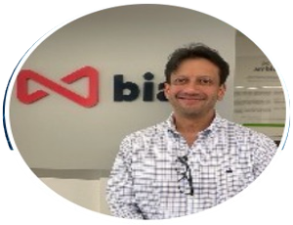
Artemis Coffee 1.0 – Workstream 2 & 3 - Capabilities
THE NOURISHING ALLIANCE
By prioritizing the workstreams , we define the owners responsable for mapping, assessing, and recommending the strategic actions for Priority 2 and 3– Capabilities and New Brands/Portfolio
WORKSTREAMS
Expansion
2. Capabilities
3. M&A
Lead Team
Expert Team
Verónica
Cosenza
Beto Paiz
Luis
Jimenez
Mariposa
Capital
Market Lead
Champion Local
Carolina Vasquez
(TBC Caio)
ENABLERS
G&G
Capex
RTM
Alternative Business Model
Additional Structure

Slide 42
Artemis Coffee 1.0 – Workstream 4 – Across Market Solutions
Premium
Capsules regional solution
Brand Development and Positioning toolkit
Seasonals platfom
Packaging scope
(glass, flexible, pet, etc.)

Slide 43
Artemis Coffee 1.0- Project One Pager Summary
THE NOURISHING ALLIANCE
Purpose
THE NOURISHING ALLIANCE
To build the fastest-growing Coffee House of Brands in Americas, connecting local coffee heritage with our consumers. (wip)
Objective
1 Bi NR +$250 mi EBITDA by 2032
Key Output
Strategic roadmap how to build up the key growth workstreams
Main
Workstreams
Ways of Working
Steering Committee
Multi-functional Routine
Weekly Sprints
4. Across markets solutions that enable N5 Plays.

